Slide 1


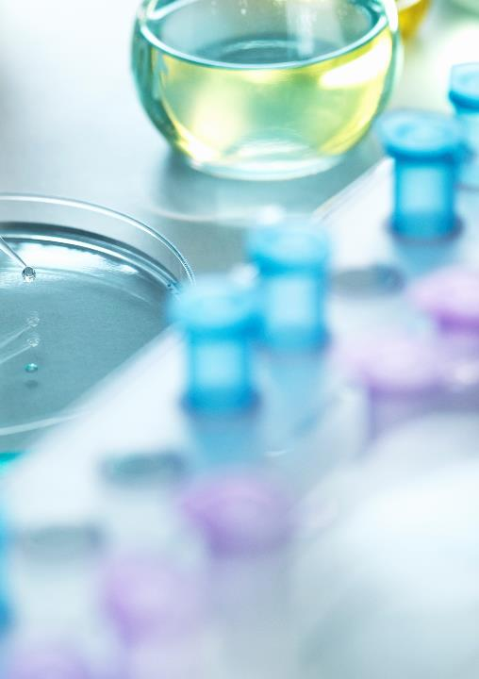
An Evidence Based Approach to Investigations for the Ear, Nose & Throat System
Developed by Joanne Opsteen NP-PHC BScN MSc
Revised by dr lynne Thibeault, NP-PHC & Dr. Sarah Ashfield NP-PHC, PhD

Slide 2
Common tests used for the ENT system
Throat culture for group A streptococcus (GAS)
Rapid antigen detection tests for group A streptococcus (GAS) (rat)
Culture and sensitivity (C&S) (indicate site)
CBC with differential
Heterophile antibody test (monospot) for epstein-barr virus
ESR
Audiometry – test for hearing loss
Tympanometry – tests middle ear function

Slide 3
Pharyngitis
Mark is a 13-year-old male who presents with a 3-day history of fever, fatigue, sore throat and swollen tender glands. He denies any cough. His past medical history is unremarkable.
Physical exam: t 37.8 c with anterior and posterior cervical node lymphadenopathy, and tonsillar exudate and swelling. No splenomegaly. Sore throat score = 4.
The office rapid antigen detection test (rapid strep) is negative.
The np orders cbc, heterophile antibody “monospot” test and throat culture.

Slide 4
Rapid antigen detection tests (RAT) for group A streptococcus (GAS)
Sensitivity of 70-90%; specificity 95-100%
Negative RAT in children and adolescents (age 3-14 year of age) needs confirmation with culture.
Positive RAT do not necessitate a back-up culture
Does not differentiate between viable and nonviable bacteria
False positive = non-pathogenic oral streptococci. Wait 3-4 weeks after treatment of confirmed cause of GAS. Perform culture if questioning possible reoccurrence.
https://cps.ca/en/documents/position/group-a-streptococcal
Gerber et al (2004). Rapid Dx of pharyngitis caused by GAS. Clinical Microbio Rev, 17, 3, 571-580
Shulman et al (2012). CPG for Dx & Mgt GAS pharyngitis. Clin Infect Disease, 55,10, e86-e102
https://www.aacc.org/cln/articles/2018/september/the-evolution-of-group-a-streptococcus-pharyngitis-testing

Slide 5

Pharyngitis
Mark’s results:
Hgb 158 g/l
⬆ Wbc 13.0x10⁹/L (3.5-10.5)
Platelets 150x10⁹/L
Differential:
↓ Neutrophils 1.9x10⁹/L (2-7)
⬆ Lymphs 10.0 x10⁹/L (1.5-3.4)
Monocytes 0.8x10⁹/L
Eosinophils 0.4x10⁹/l
Basophils 0.0x10⁹/L
Comment: moderate atypical lymphocytes
Heterophile test negative
Throat culture negative for GAS

Slide 6
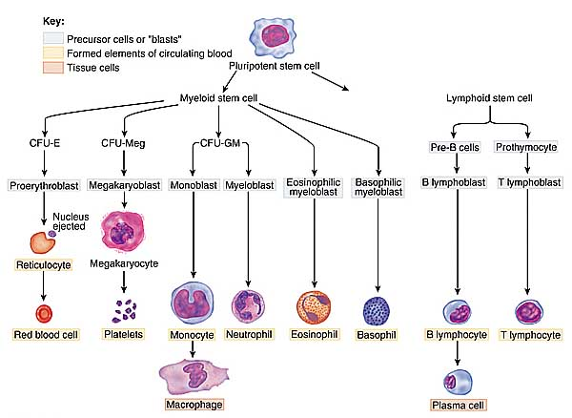

Slide 7
WBC (3.5-10.5 x10 9/L)
Leukocytosis
Reactive
  Infection
  Inflammation
  Stress
Neoplastic
  Leukemias & other hematologic disorders
  * Differential wbc count usually abnormal
Leukopenia
Overwhelming infection
Bone marrow failure
Autoimmune disease
Drugs - most common cause of acquired leukopenia
More common in Black & Asian population
Maunder, R. (2011). Understanding laboratory tests. Elsevier Saunders, Toronto

Slide 8

Neutrophils
Neutrophilia
Acute bacterial infection
Tissue necrosis
Hemolysis
Acute hemorrhage
Leukemia
Neutropenia
Infections: viral illnesses (HIV, hepatitis), malaria, typhoid fever
Drugs
Bone marrow suppression
Splenomegaly
Severe and prolonged illness
Lower Blacks and Asians

Slide 9
Lymphocytes
Lymphocytosis
Acute viral infections (mono)
Some chronic infections: viral hepatitis
Malignancies
Adrenal insufficiency
Lymphocytopenia
Immunodeficiency diseases (AIDS)
Bone marrow suppression
Malignancies
Steroid use
Systemic lupus

Slide 10

Monocytes
Monocytosis
Recovery phase of acute bacterial infections
Chronic bacterial infections (TB)
Chronic inflammatory disorders (Crohn’s disease)
Proliferative bone marrow disorders
Monocytopenia
Corticosteroid use

Slide 11

Eosinophils
Eosinophilia
3 W’s
Worms - parasitic infections
Wheezes – allergic disorders, drug reactions
Weird diseases –Addison, neoplasms
Eosinopenia
Corticosteroid use
Stress
Drugs

Slide 12

Basophils
Basophilia
Myeloproliferative disease (leukemia) until proven otherwise
Acute inflammation
Allergic reaction
Basopenia
Not generally a clinical problem

Slide 13
Pharyngitis
Hb 158g/L
⬆ WBC 13.0x10⁹/L (3.5-10.5)
Platelets 150x10⁹/L
Differential:
↓ Neutrophils 1.9x10⁹/L (2-7)
⬆ Lymphs 10.0 x10⁹/L (1.5-3.4)
Monocytes 0.8x10⁹/L
Eosinophils 0.4x10⁹/l
Basophils 0.0x10⁹/L
Comment: moderate atypical lymphocytes
Heterophile “ monospot”
test negative
Leukocytosis (⬆ WBC)
Neutropenia (↓ Neutrophils)
Lymphocytosis (⬆ Lymphs)
Throat culture negative GAS
Diagnosis: Viral etiology

Slide 14
Heterophile antibody (Monospot)
Monospot test 25% false negative rate in first week & 5% in week 3
Consider repeating heterophile antibody in 7-14 days if patient still symptomatic to rule in/out mononucleosis
Lower sensitivity in children < 12 years of age & immunocompromised - order epstein-barr serology
Smellie W.S.A. et al (2007). Best practice in primary care pathology: review 7. J. Clin. Pathol. 60, 458-465

Slide 15
References
Anti-Infective Review Panel. (2019). Anti-infective guidelines for community-acquired infections. Toronto: MUMS.
Gerber et al (2004). Rapid dx of pharyngitis caused by GAS. Clinical Microbio Rev, 17, 3, 571-580
Maunder, R. (2011). Understanding laboratory tests. Elsevier Saunders, Toronto
Pagana K.& Pagana T. Editor Macdonald, S. (2018). Mosby’s Canadian Manual of Diagnostic and Laboratory Tests. 2nd Canadian edition. Toronto: Elsevier Mosby.
Shafarenko, Mark and Tofighi, Tara (2019). Toronto notes: Comprehensive Medical Reference and Review for MCCQE I & USMLE II. 35th Edition Toronto: Toronto notes for medical students inc.
Shulman et al (2012). CPG for dx & mgt GAS pharyngitis. Clin Infect Disease, 55,10, e86-e102
Smellie W.S.A. Et al (2007). Best practice in primary care pathology: Review 7. J. Clin. Pathol. 60, 458-465
Trelease, Bell, et al (2006). What test is the best for diagnosing infectious mononucleosis. The Journal of Family Practice, 55, 9, 799-802.

